Slide 1
Jos Lab & Bos Lab
Bos Lab
User-level libraries (no kernel support)
以1：N为例
预备知识
C/C++基本语法（C primer plus/C++ primer）
相关工具链Gcc，gdb，makefile（官方文档、博客）
X86汇编基本知识（书、博客）
操作系统
相关的数据结构
相关的函数

Slide 2
Jos Lab & Bos Lab
Bos Lab
预备知识
C
多文件编译 .h/.c
.h中写结构体的定义，函数、全局变量的声明；注意#ifdef
.c中写函数、全局变量的定义
Gcc
gcc -m32 -O0 (-g) thread.c list.c context.S -o lab1 -DDEBUG
Gdb
基本用法：b/r/c/n/s/i/help
命令行下的图形化：ctrl+x a ctrl+x o
同时查看多种信息：layout
观察内存信息：x/Nx ptr

Slide 3
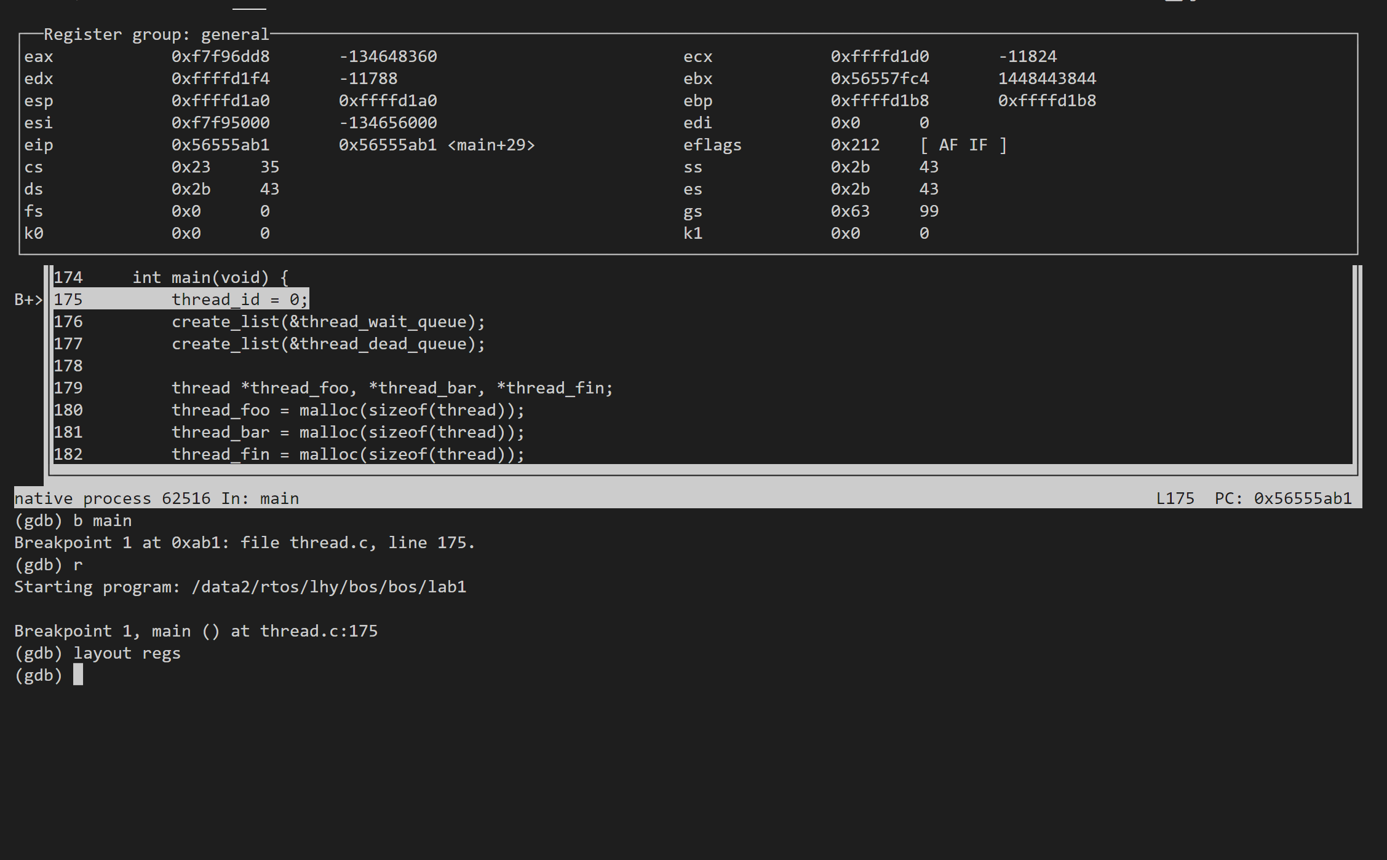
Jos Lab & Bos Lab
Bos Lab
预备知识
C
多文件编译 .h/.c
.h中写结构体的定义，函数、全局变量的声明；注意#ifdef
.c中写函数、全局变量的定义
Gcc
gcc -m32 -O0 (-g) thread.c list.c context.S -o lab1
Gdb
基本用法：b/r/n/s
命令行下的图形化：ctrl+a x
Vscode下的图形化
同时查看多种信息：layout

Slide 4
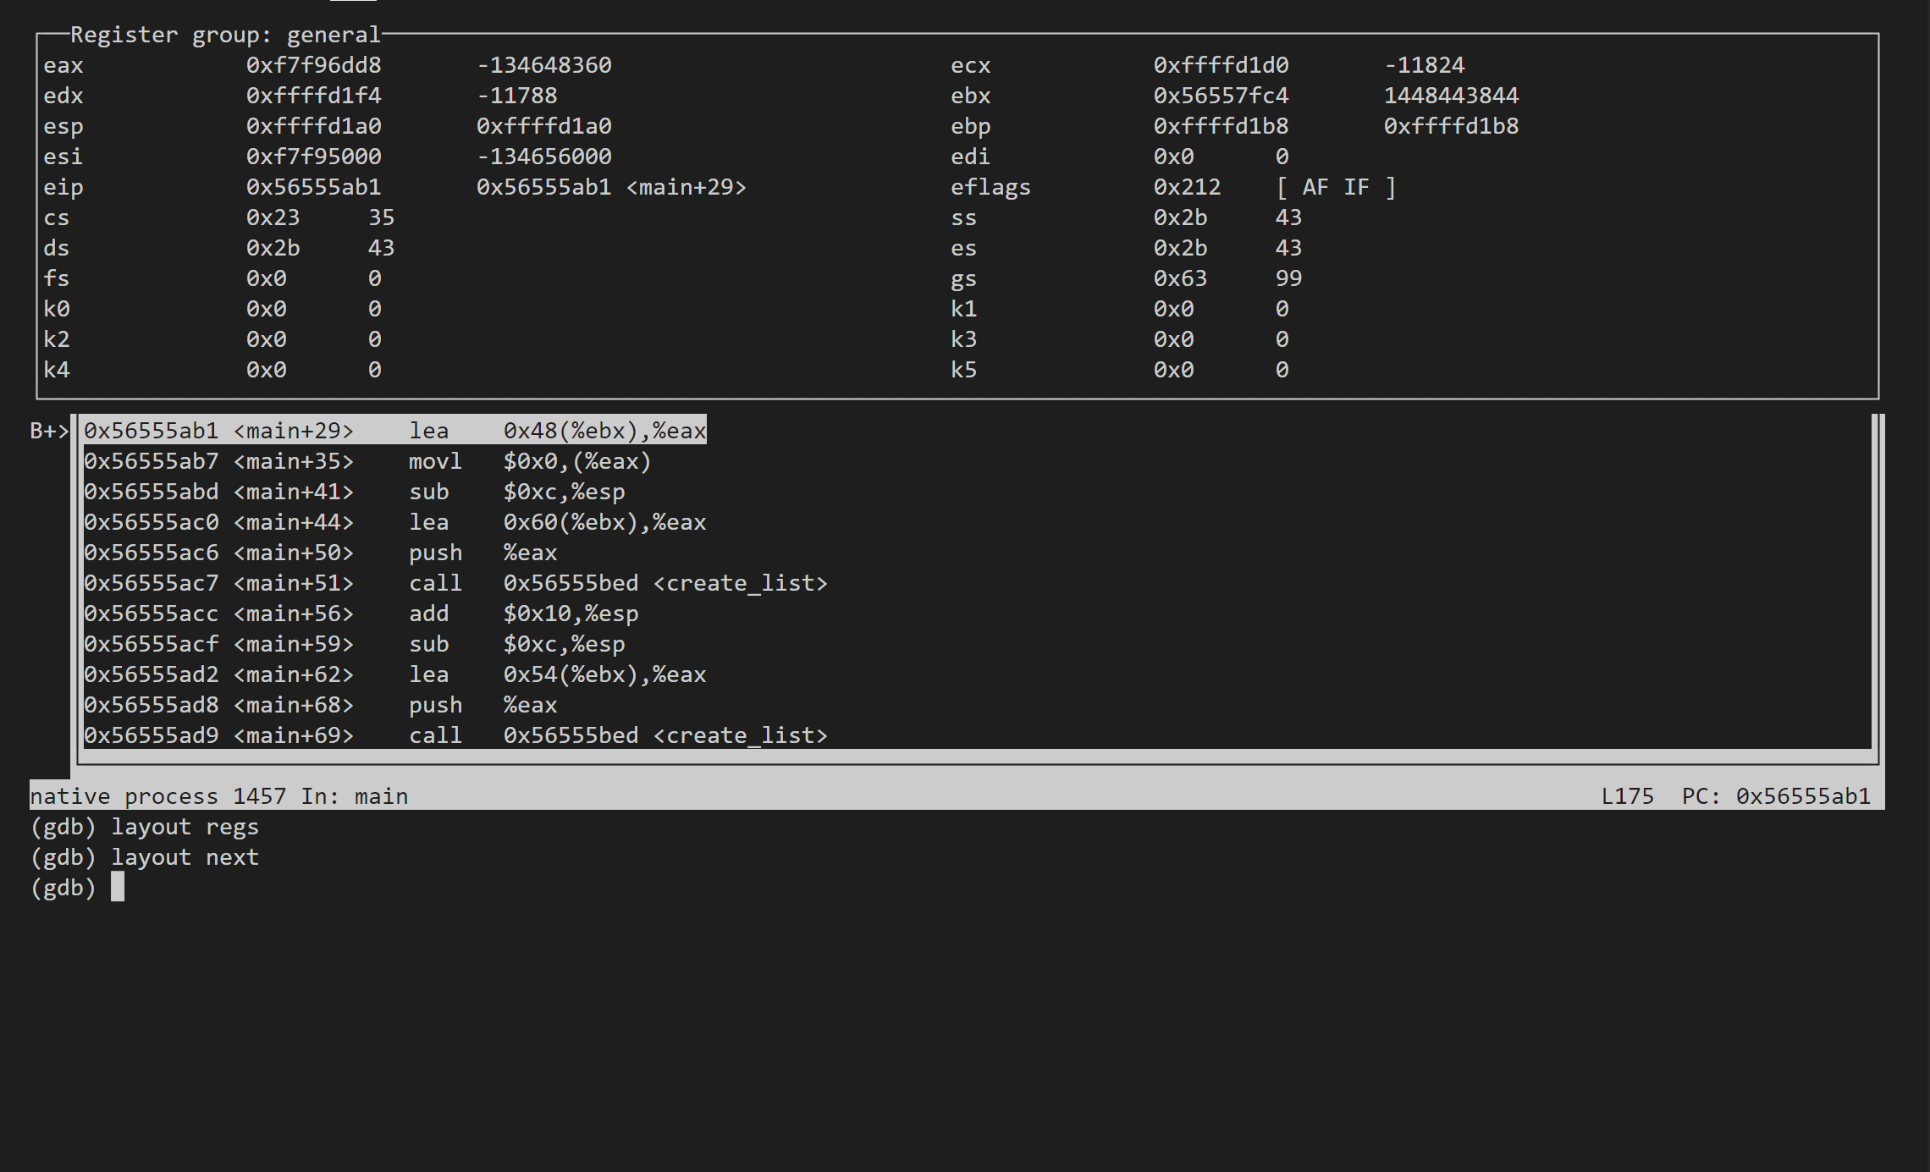
Jos Lab & Bos Lab
Bos Lab
预备知识
C
多文件编译 .h/.c
.h中写结构体的定义，函数、全局变量的声明；注意#ifdef
.c中写函数、全局变量的定义
Gcc
gcc -m32 -O0 (-g) thread.c list.c context.S -o lab1
Gdb
基本用法：b/r/n/s
命令行下的图形化：ctrl+a x
Vscode下的图形化
同时查看多种信息：layout

Slide 5
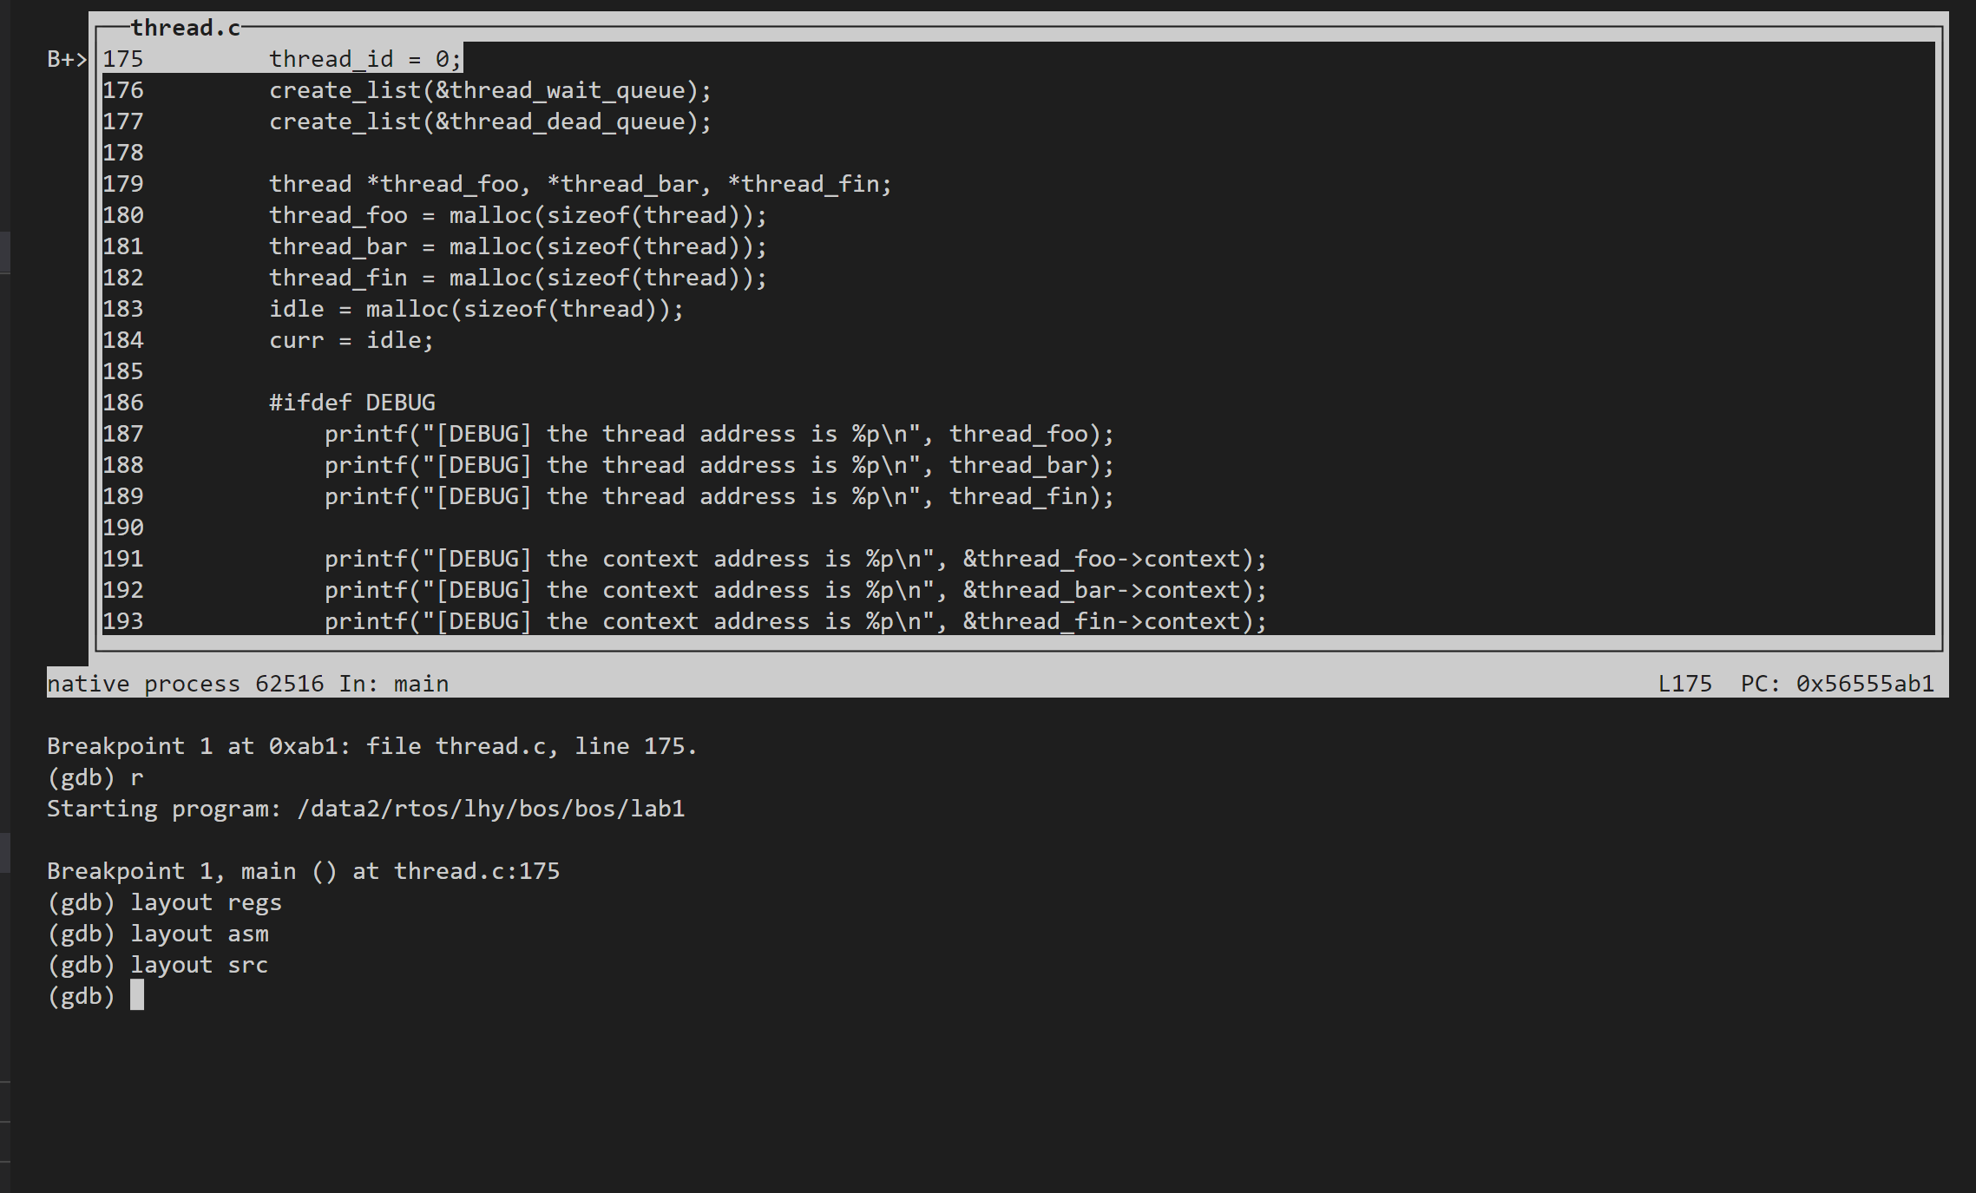
Jos Lab & Bos Lab
Bos Lab
预备知识
C
多文件编译 .h/.c
.h中写结构体的定义，函数、全局变量的声明；注意#ifdef
.c中写函数、全局变量的定义
Gcc
gcc -m32 -O0 (-g) thread.c list.c context.S -o lab1
Gdb
基本用法：b/r/n/s
命令行下的图形化：ctrl+a x
Vscode下的图形化
同时查看多种信息：layout

Slide 6
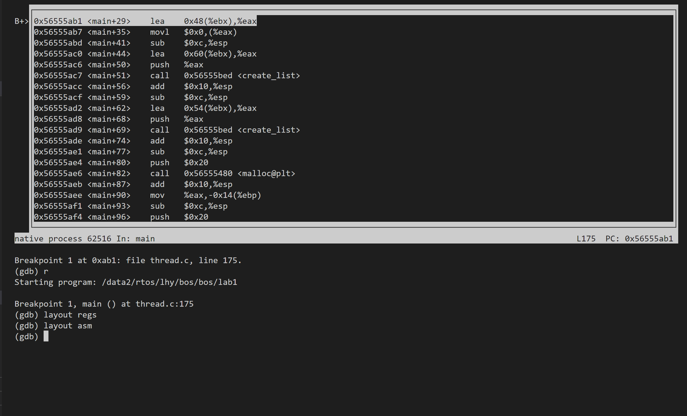
Jos Lab & Bos Lab
Bos Lab
预备知识
C
多文件编译 .h/.c
.h中写结构体的定义，函数、全局变量的声明；注意#ifdef
.c中写函数、全局变量的定义
Gcc
gcc -m32 -O0 (-g) thread.c list.c context.S -o lab1
Gdb
基本用法：b/r/n/s
命令行下的图形化：ctrl+a x
Vscode下的图形化
同时查看多种信息：layout

Slide 7
Jos Lab & Bos Lab
Bos Lab
预备知识
Gdb
基本用法：b/r/c/n/s/i/help
命令行下的图形化：ctrl+x a ctrl+x o
同时查看多种信息：layout
观察内存信息：x/Nx ptr
打印结构体：p *(type) ptr (tab补全)
watchpoint
Record
Python脚本
……

Slide 8
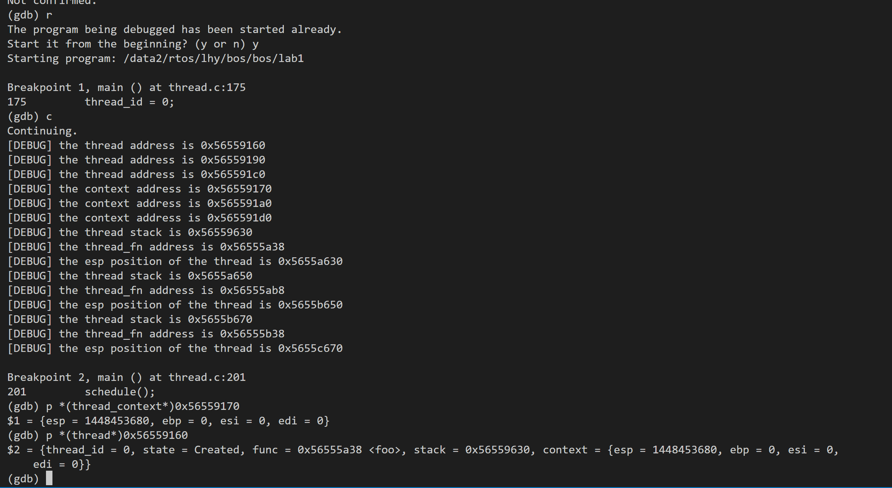
Jos Lab & Bos Lab
Bos Lab
预备知识
Gdb
基本用法：b/r/c/n/s/i/help
命令行下的图形化：ctrl+a x (vscode下的图形化)
同时查看多种信息：layout
观察内存信息：x/Nx ptr
打印结构体：p (type) ptr (tab补全)
watchpoint
Record
Python脚本
……

Slide 9
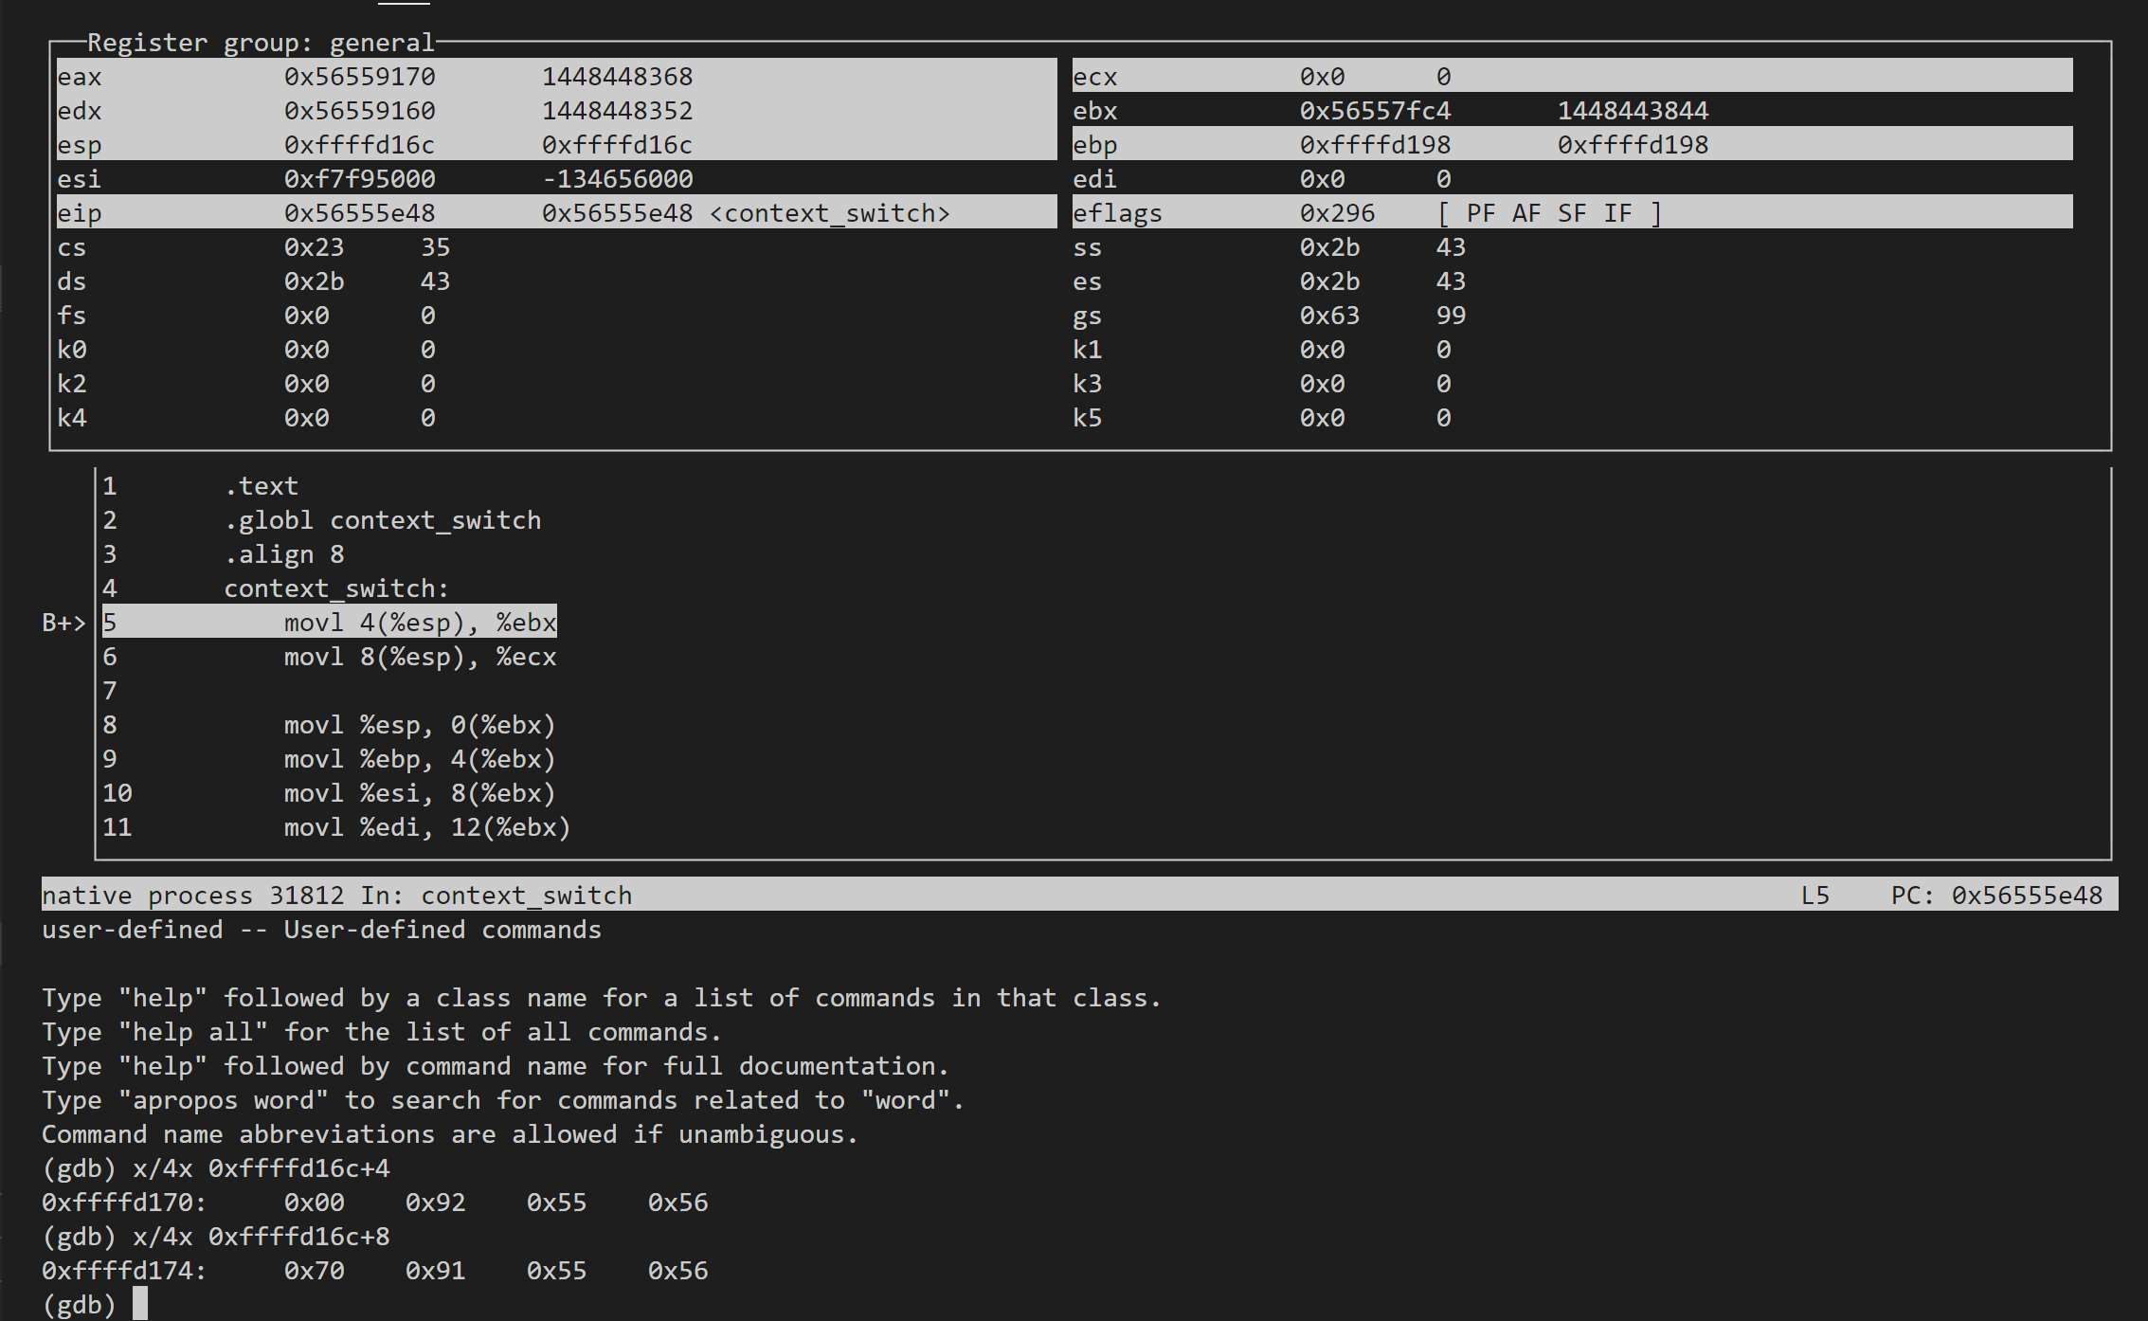
Jos Lab & Bos Lab
Bos Lab
预备知识
Gdb
基本用法：b/r/c/n/s/i/help
命令行下的图形化：ctrl+x a ctrl+x o
同时查看多种信息：layout
观察内存信息：x/Nx ptr
打印结构体：p *(type) ptr (tab补全)
watchpoint
Record
Python脚本
……

Slide 10
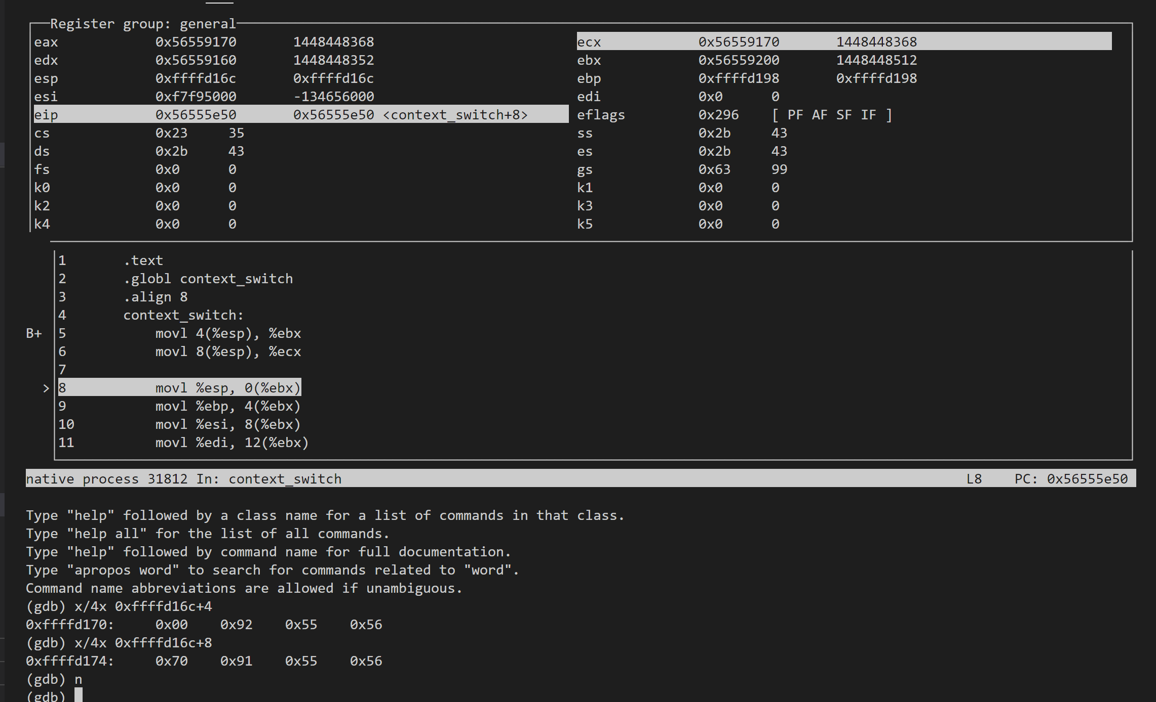
Jos Lab & Bos Lab
Bos Lab
预备知识
Gdb
基本用法：b/r/c/n/s/i/help
命令行下的图形化：ctrl+x a ctrl+x o
同时查看多种信息：layout
观察内存信息：x/Nx ptr
打印结构体：p *(type) ptr (tab补全)
watchpoint
Record
Python脚本
……

Slide 11
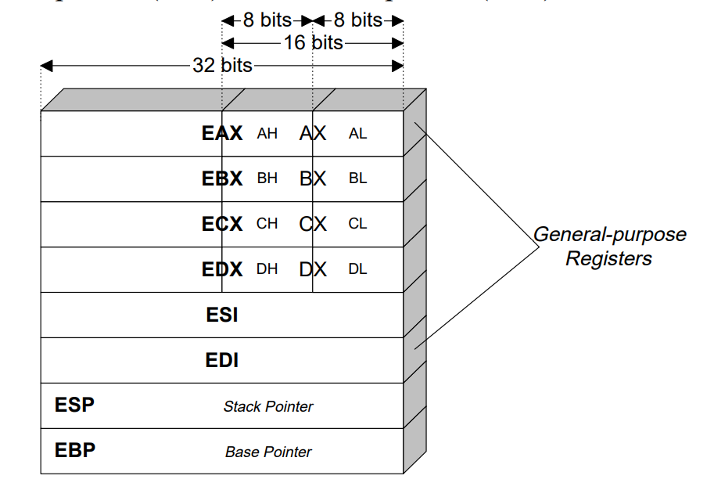
Jos Lab & Bos Lab
Bos Lab
预备知识
X86汇编
基础语法 at&t
相关寄存器
The C Calling Convention

Slide 12
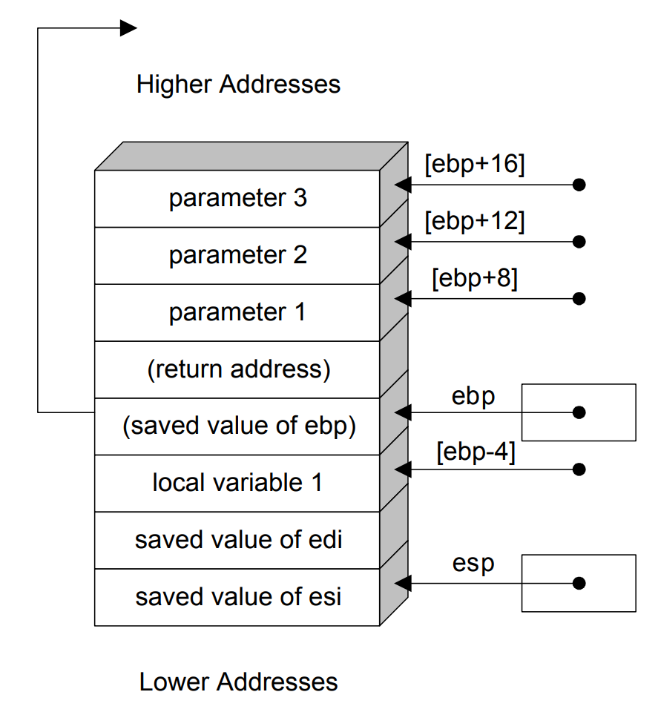
Jos Lab & Bos Lab
Bos Lab
预备知识
X86汇编
基础语法 at&t
相关寄存器
The C Calling Convention
Caller/Callee-saved 寄存器
EBX, ECX, EDX
ESI, EDI, ESP, EBP
Call/ret

Slide 13
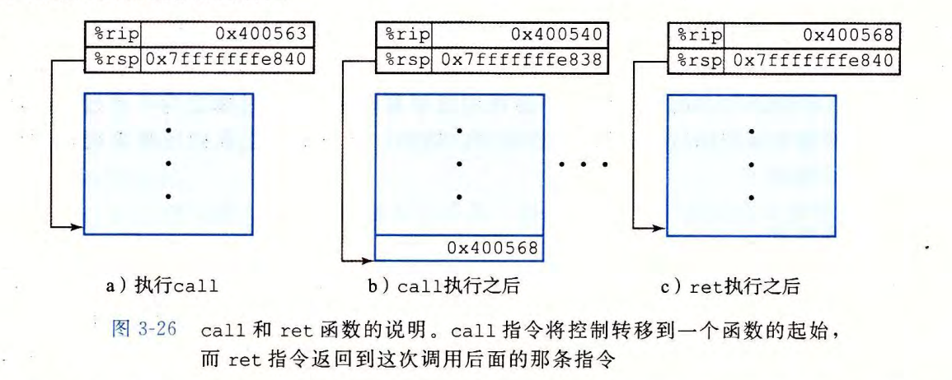
Jos Lab & Bos Lab
Bos Lab
预备知识
X86汇编
基础语法 at&t
相关寄存器
The C Calling Convention
Caller/Callee-saved 寄存器
EBX, ECX, EDX
ESI, EDI, ESP, EBP
Call/ret

Slide 14
Jos Lab & Bos Lab
Bos Lab
操作系统
数据结构
Thread tcb
Thread of list

Slide 15
Thread Data Structures
Thread Control Block (TCB)
Stack pointer: each thread needs their own stack
Copy of processor registers
General-purpose registers for storing intermediate values
Special-purpose registers for storing instruction pointer and stack pointer
Metadata
Thread ID
Scheduling priority
Status

Slide 16
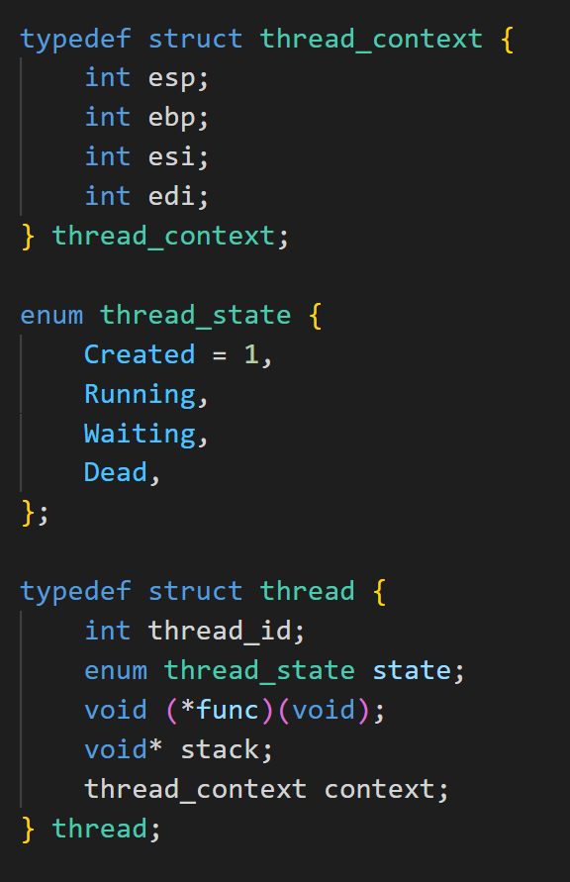
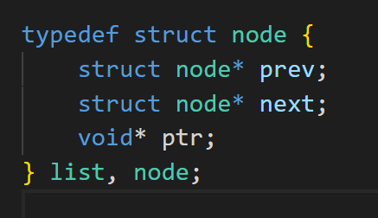
Thread Data Structures
Thread Control Block (TCB)
Stack pointer: each thread needs their own stack
Copy of processor registers
General-purpose registers for storing intermediate values
Special-purpose registers for storing instruction pointer and stack pointer
Metadata
Thread ID
Scheduling priority
Status
https://github.com/torvalds/linux/blob/master/tools/perf/util/thread.h

Slide 17
Jos Lab & Bos Lab
Bos Lab
操作系统
数据结构
Thread tcb
Thread of list
函数

Slide 18
Implementing Kernel Threads
void thread_create(thread_t *thread, void (*func)(int), int arg) {
TCB *tcb = new TCB();
thread->tcb = tcb;
tcb->stack_size = INITIAL_STACK_SIZE;
tcb->stack = new Stack(tcb->stack_size);
tcb->sp = tcb->stack + tcb_stack_size;
tcb->pc = stub;
*(tcb->sp) = arg;
tcb->sp --;
*(tcb->sp) = func;
tcb->sp --;
thread_dummySwitch(tcb);
tcb->state = READY;
readyList.add(tcb);
}
void stub(void (*func)(int), int arg) {
(*func)(arg);
thread_exit(0);
}
Create a thread
Allocate per-thread state: the TCB and stack
Initialize per-thread state: registers (args)
Put TCB on ready list
// explained later
void thread_dummySwitch(newThread) {
*(tcb->sp) = stub;
tcb->sp--;
tcb->sp -= SizeOfPopad;
}

Slide 19
Implementing Kernel Threads
Delete a thread
Remove the thread from the ready list so it will never run again
Free the per-thread state allocated for the thread
Can a thread delete its own state?
A bad case: a thread removes itself from the ready list, and an interrupt occurs..
A worse case: a thread frees its own state (stack), and..
Solution
The thread moves its TCB from the ready list to a list of finished threads
Let other threads free those finished threads

Slide 20
Implementing Kernel Threads
(Voluntary) kernel thread context switch
thread_yield()
(Involuntary) kernel thread context switch
Interrupts, exceptions

Slide 21
Jos Lab & Bos Lab
Bos Lab
操作系统
数据结构
Thread tcb
Thread of list
函数
Thread_Create
Schedule
Pick_next_thread
Context_switch
Thread_join
Schedule and free resources
void thread_create(thread* thread, void(*thread_fn)(void));
void idle_thread_create(thread* thread, void (*thread_fn)(void));
void schedule(void);
thread* pick_next_thread(void);
void context_switch(thread_context* prev, thread_context* next);
void threads_join(void);

Slide 22
Jos Lab & Bos Lab
Bos Lab
Tips
上下文切换
Malloc和free出现段错误考虑栈对齐
记得切回主idle进程
context_switch:
movl 4(%esp), %ebx
movl 8(%esp), %ecx
movl %esp, 0(%ebx)
movl %ebp, 4(%ebx)
movl %esi, 8(%ebx)
movl %edi, 12(%ebx)
movl 0(%ecx), %esp
movl 4(%ecx), %ebp
movl 8(%ecx), %esi
movl 8(%ecx), %edi
ret

